Slide 1


Predicting Fantasy Basketball Scores with RNNs
Morgan Bauer

Slide 2
Background

Slide 3
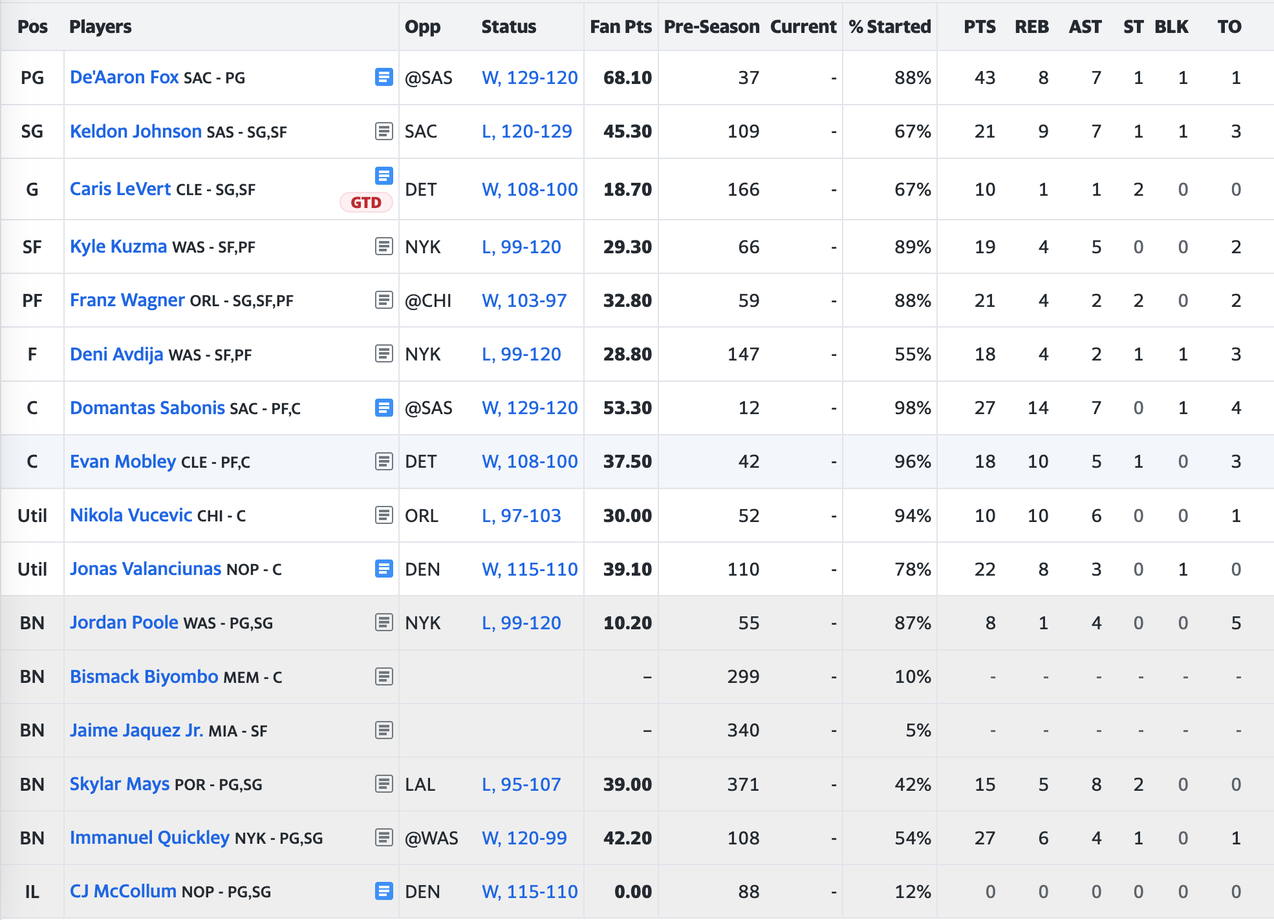
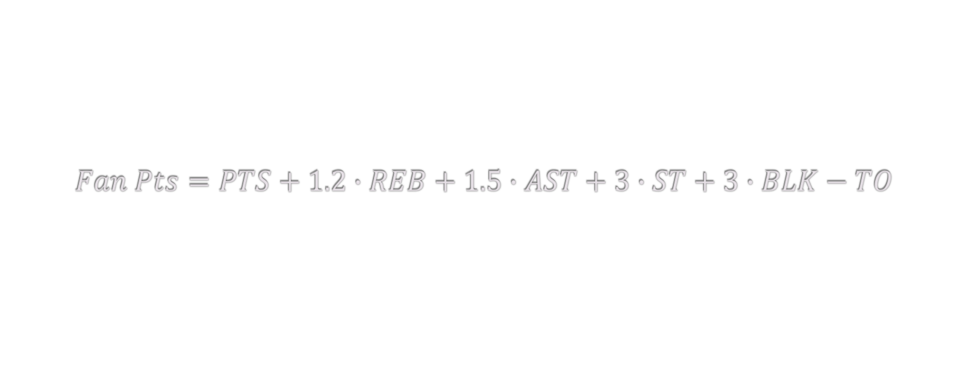
Yahoo Fantasy Basketball
$$Fan Pts=PTS+1.2∙REB+1.5∙AST+3∙ST+3∙BLK−TO$$

Slide 4
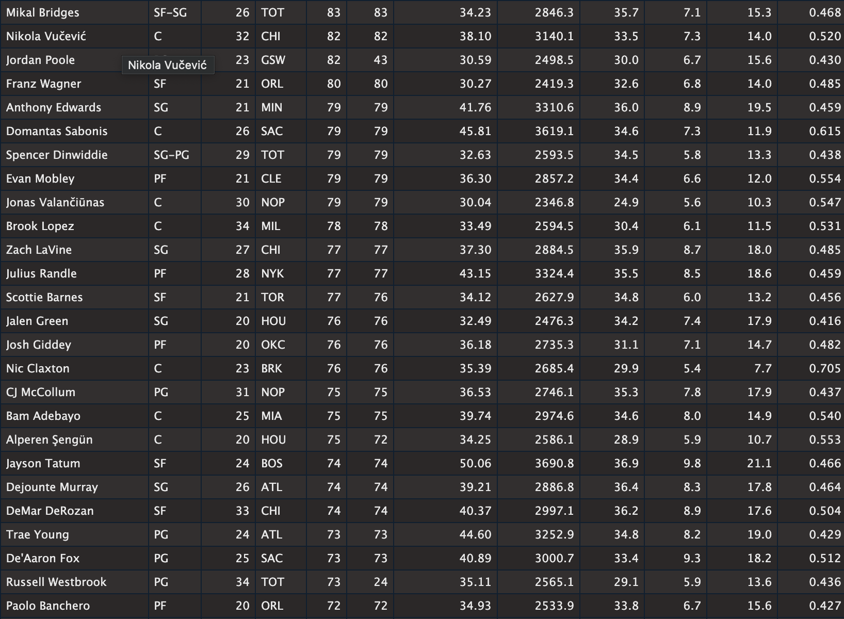
Previous Work

Slide 5
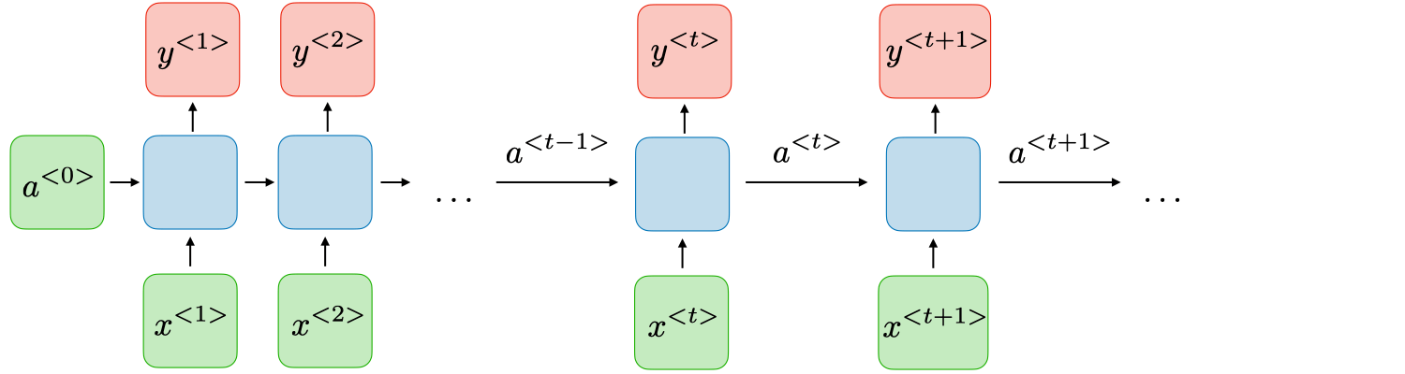
RNNs

Slide 6
Building the Dataset

Slide 7
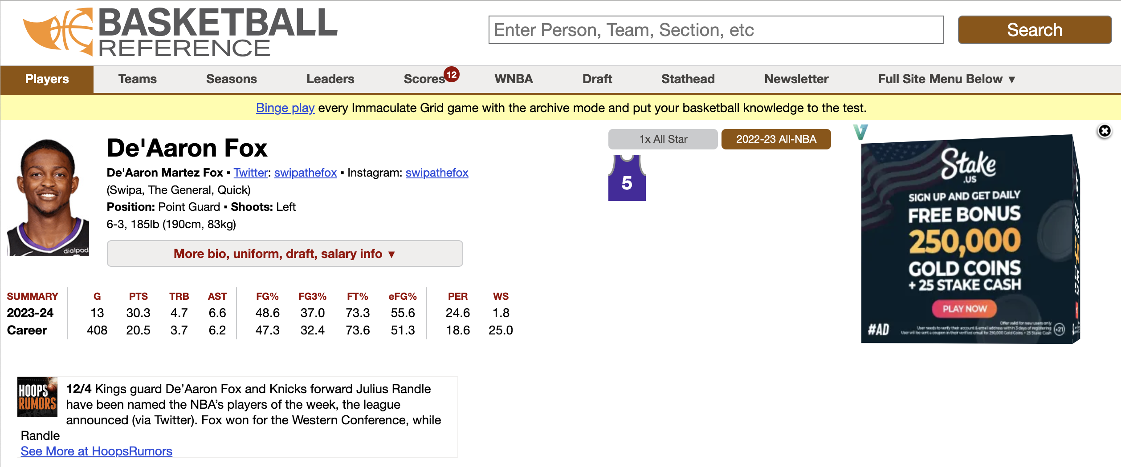
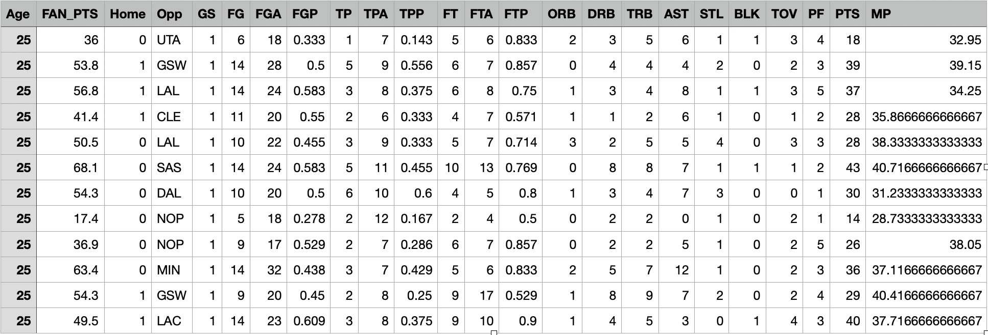

Slide 8
Preprocessing Data
Sequences of ten games
24 features, including:
Fan Pts
Home/Away
Opponent
Qualitative variables → quantitative variables
Normalization
Split into train, validation, and test

Slide 9
Network Architecture

Slide 10

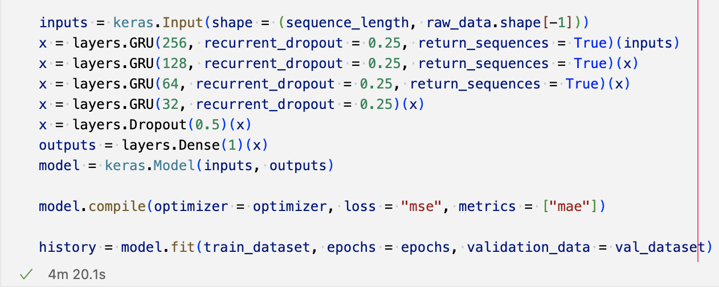

Slide 11
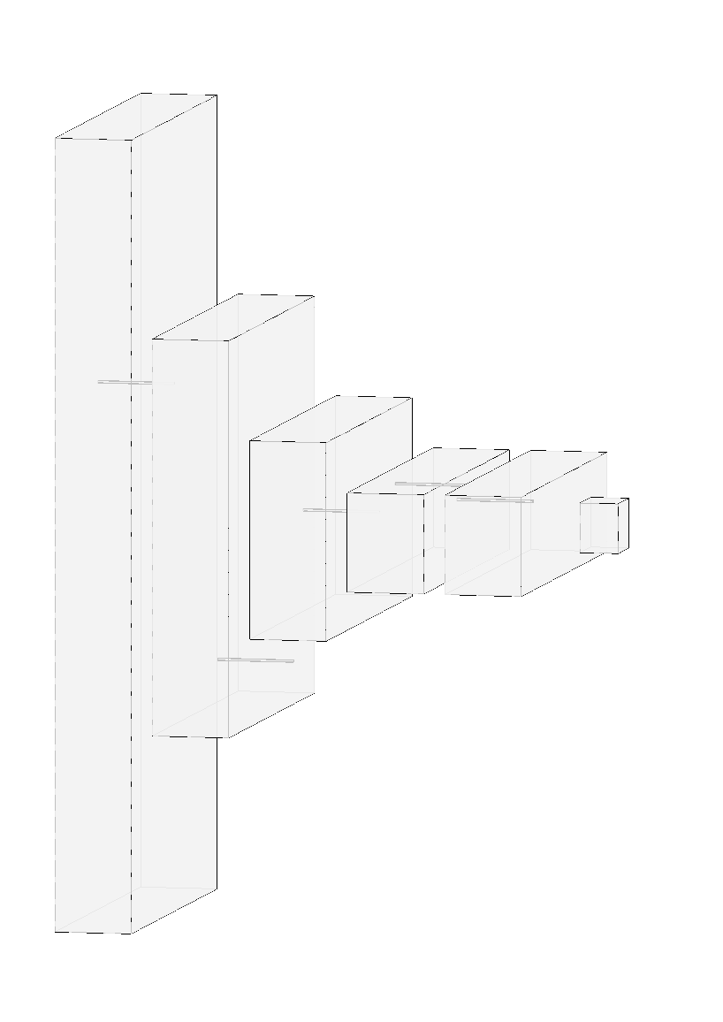

Slide 12
Results

Slide 13
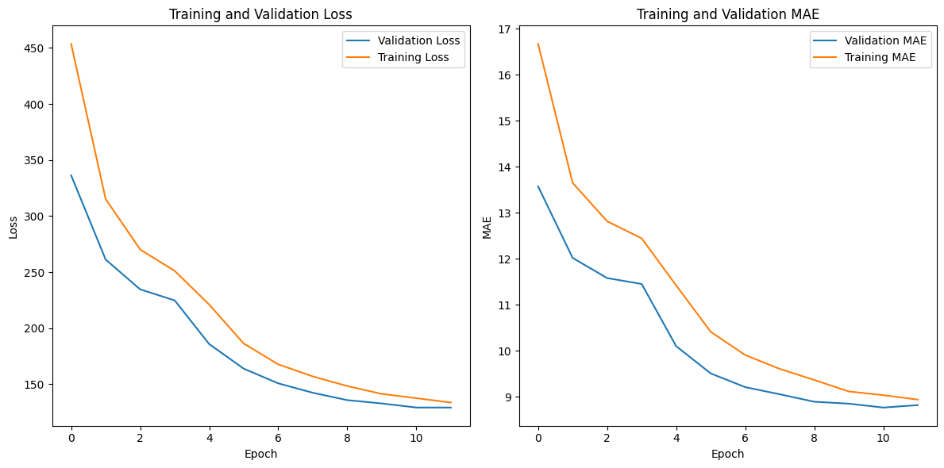

Slide 15
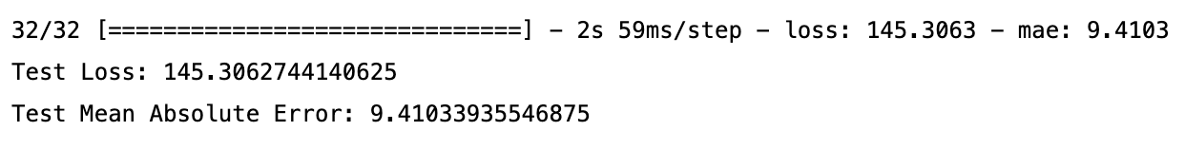

Slide 16
Next Steps
Expand dataset
Learn about more techniques for preprocessing data
Learn about more complex and powerful network architectures
Prediction during 2023 – 2024 season
Integrate into analytics platform
Predict multiple games ahead

Slide 17
Questions?

